Slide 1
Botnets and APT
35 – Jeet Vasa
07 – Priyanka Desai

Slide 2
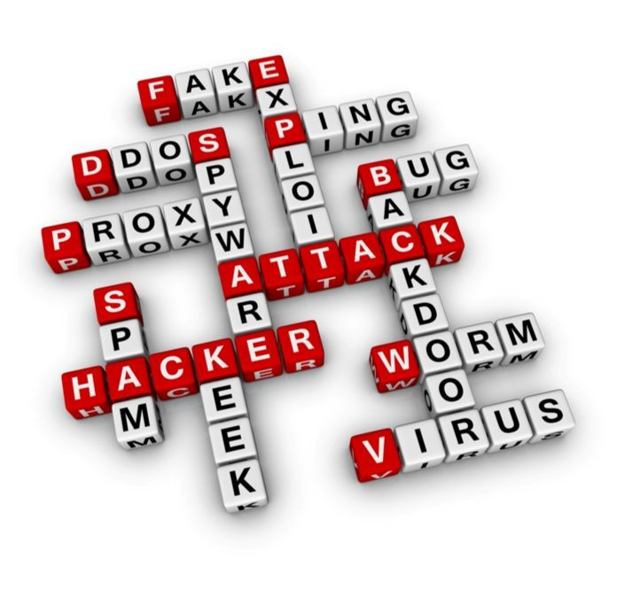
Risk & Security in Information Technology
Internet Security
Viruses, Trojans, Worms, Botnets, Adware, and Malware
Spam and Phishing
Information/data mining, theft, and loss of equipment
Internet usage to corporate policy
Unsecure networks
Denial of services
Directory harvest
Email traffic is doubling every year!!!

Slide 3
Why Talk About Botnets?
bots
Cross site scripting
Tools
“stealth” / advanced scanning techniques
High
packet spoofing
denial of service
Staged attack
sniffers
distributed
attack tools
Intruder
Knowledge
sweepers
www attacks
GUI
automated probes/scans
back doors
disabling audits
network mgmt. diagnostics
hijacking
sessions
burglaries
Attack
Sophistication
exploiting known vulnerabilities
password cracking
self-replicating code
Attackers
Low
password guessing
1980
1985
1990
1995
2000+

Slide 4
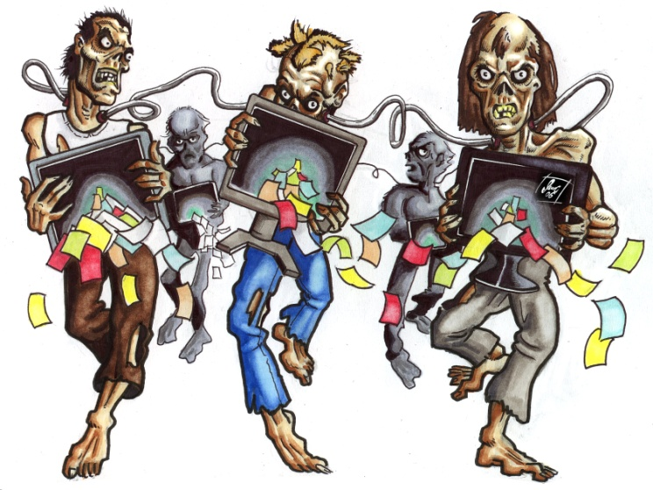
Botnets
A network of ‘bots’ also known as ‘zombies’
Collection of compromised hosts
Spread like worms and viruses
Once installed, respond to remote commands
Botnets trace their roots from Eggdrop bot

Slide 5
What are botnets used for?

Slide 6
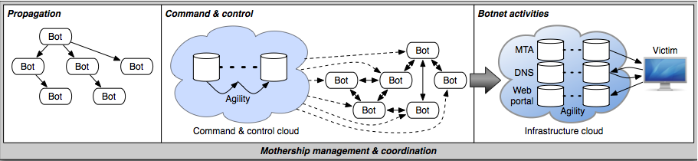
Botnet Lifecycle

Slide 7
System components
Botnet controllers: Usually compromised Unix hosts located in webhosting colo space, running ircd.
Bots: Usually compromised Windows hosts with connectivity from commercial broadband ISPs.
Spam senders: Usually located in webhosting colo space, may be bogus company, fake webhoster or fake ISP.
Proxy web interface or custom application: May be hosted/distributed through legitimate large ISPs.
Marketing/deal-making locations: Public IRC channels, web-based message boards.

Slide 8
Human components
Bot developer: Develops (or more commonly, modifies existing) bot code.
Exploit developer: Develops code to exploit vulnerabilities.
Botherd: Collects and manages bots (Command and Control Channel).
Botnet seller: Sells the use of bots (or proxies) to spammers.
Spammer: Sends spam.
Sponsor: Pays spammer to promote products or services. Money launderer (“payment processor”): Work-at-home opportunity to process payments/launder money for “sponsors.”
Phishers: Collectors of user identity and bank information.
Cashers: Use phished bank data to make fake ATM cards and withdraw funds.

Slide 9
Most commonly used Bot families
Agobot
SDBot
SpyBot
GT Bot

Slide 10
Agobot
Most sophisticated
20,000 lines C/C++ code
IRC based command/control
Large collection of target exploits
Capable of many DoS attack types
Shell encoding/polymorphic obfuscation
Traffic sniffers/key logging
Defend/fortify compromised system
Ability to frustrate dissassembly

Slide 11
SDBot
Simpler than Agobot, 2,000 lines C code
Non-malicious at base
Utilize IRC-based command/control
Easily extended for malicious purposes
Scanning
DoS Attacks
Sniffers
Information harvesting
Encryption

Slide 12
SpyBot
<3,000 lines C code
Possibly evolved from SDBot
Similar command/control engine
No attempts to hide malicious purposes

Slide 13
GT Bot
Functions based on mIRC scripting capabilities
HideWindow program hides bot on local system
Basic rootkit function
Port scanning, DoS attacks, exploits for RPC and NetBIOS

Slide 14
Type of Propagation
IRC Botnet
P2P Botnet
HTTP Botnet

Slide 15



IRC (Internet Relay Chat) Botnet
+
Botnet user

Slide 16

P2P Botnet

Slide 17
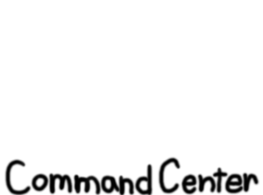

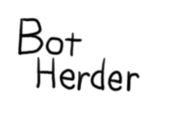
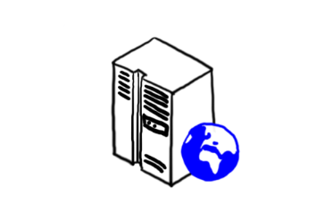

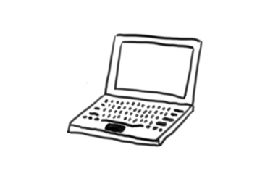

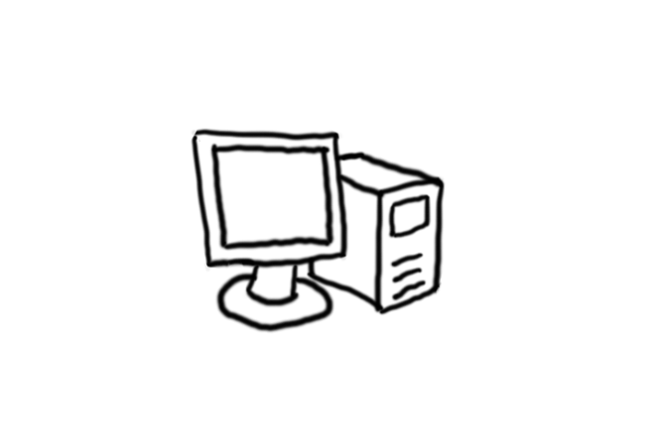

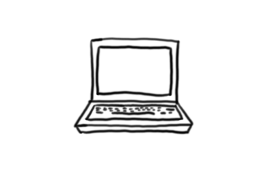
HTTP Botnet
HTTP Post Command
to C&C URL

Slide 18
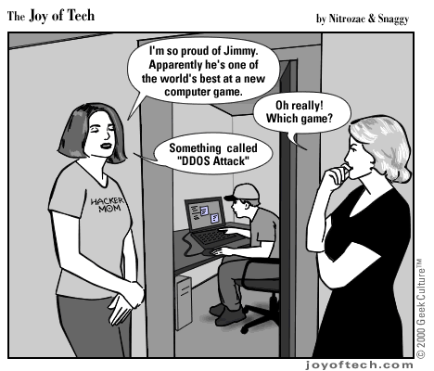
Botnet Powered Attacks
With full control of a massive army of machines, the only limit to a botherder’s attack potential is his imagination.
Distributed Denial of Service (DDoS) Attacks
BlueSecurity
Estonia
Extortion of small businesses
Spamming
Email spam
SPIM
Forum spam

Slide 19
Hiring Botnets
Phishing
Spam
Distributed Denial of Service
Click Fraud
Adware/Spyware Installation
Identity Theft
Making Additional Income!!!
Keystroke logging
Stealing registration keys or files

Slide 20
Botnet Defence
Protecting your network from a botnet’s many attack vectors requires “Defense in Depth.”
Use a Firewall
Patch regularly and promptly
Use Antivirus software
Deploy an Intrusion Prevention System
Implement application-level content filtering
Define a Security Policy and share it with your users systematically

Slide 21
Advanced Persistent Threat (APT)

Slide 22
What is APTs?
Advanced
– Attacker adapts to defenders’ efforts
– Can develop or buy Zero-Day exploits
– Higher level of sophistication
Persistent
– “Low” and “Slow”
– Attacks are objective and specific
– Will continue until goal is reached
– Intent to maintain long term connectivity
Threats
– Entity/s behind the attack
– Not the malware/exploit/attack alone

Slide 23
APT Characteristics
Bodmer, Kilger, Carpenter and Jones defined the following APT criteria:
Objectives – The end goal of the threat, your adversary
Timeliness – The time spent probing and accessing your system
Resources – The level of knowledge and tools used in the event (skills and methods will weigh on this point)
Risk tolerance – The extent the threat will go to remain undetected
Skills and methods – The tools and techniques used throughout the event

Slide 24
Actions – The precise actions of a threat or numerous threats
Attack origination points – The number of points where the event originated
Numbers involved in the attack – How many internal and external systems were involved in the event, and how many people's systems have different influence/importance weights
Knowledge source – The ability to discern any information regarding any of the specific threats through online information gathering (you might be surprised by what you can find by being a little proactive)

Slide 25
Stages of APT
1. Reconnaissance:
Collecting information about Organization’s resources
2. Delivery:
Spear phishing emails are prepared and sent
3. Exploitation:
Command and control connection is build from targeted employee’s machine via remote access

Slide 26
4. Operation:
Persistent presence in network and gain access to data
5. Data Collection:
Information is packed, compressed and encrypted
6. Exfiltration:
Data is moved over channels to various external servers

Slide 27
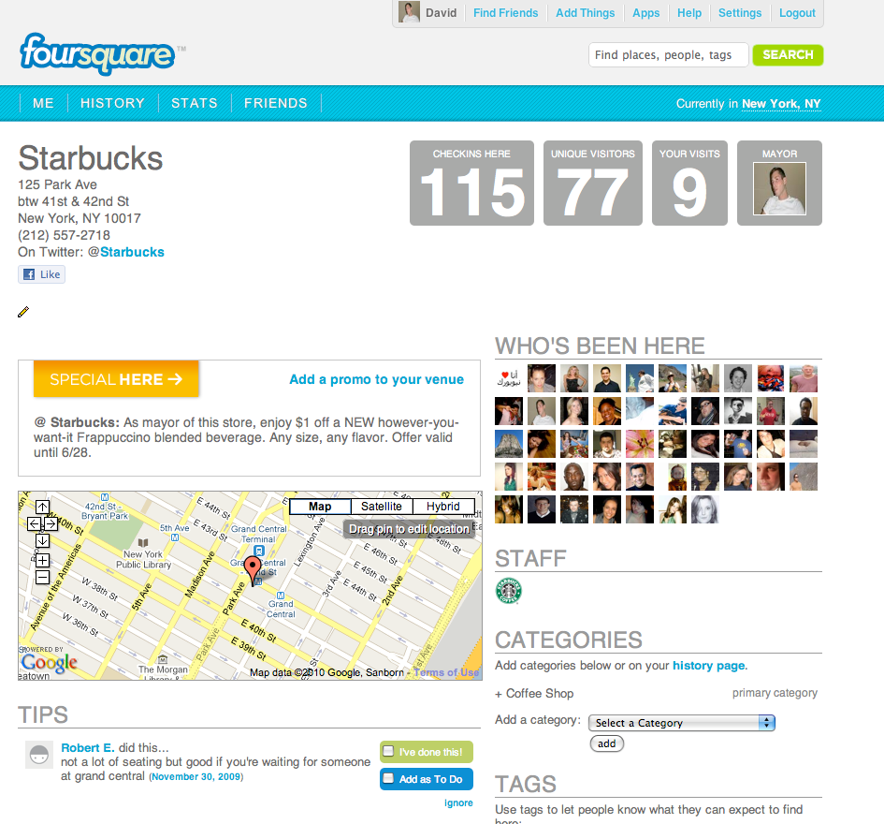

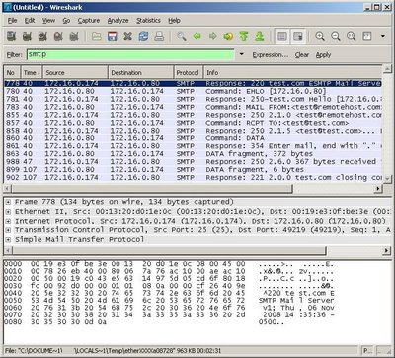

Step 1: Recon
Twitter → Starbucks
LinkedIn→ Sniffing
Captured: Email address (engineer@gmail.com)
Friend’s email (engineer2@gmail.com)
Interests (www.ITECH-2013.com)

Slide 28
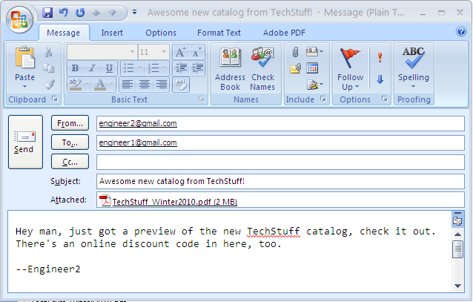
Step 2: Targeted Attack
Hey look! An email from Engineer2. With a catalog attached!
Spoofed, of course
Most certainly clicking here
CLICK HERE TO VIEW “ITECH” EVENT 2013

Slide 29
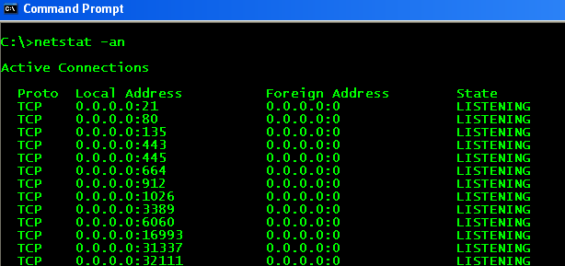
Step 3: Gaining Access
The PDF gets clicked.
Code gets dropped.
The backdoor is opened.

Slide 30
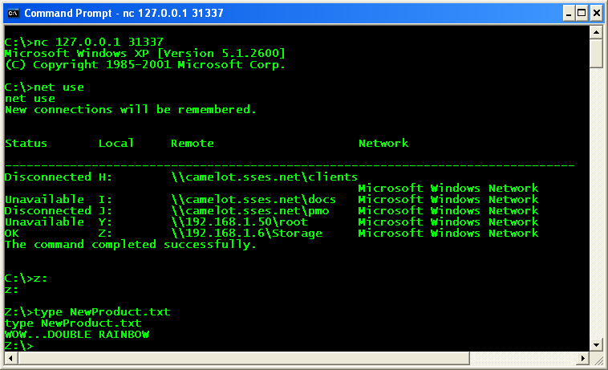
Step 4: Command & Control
The attacker connects to the listening port i.e. Remote Access

Slide 31

Step 5: Data Packaging
At this point, the attacker could do any number of things to get more sensitive data

Slide 32


